Slide 1
Writing Terraform Providers
Johan Bloemberg @ Fullstaq

Slide 2
Introduction
Johan Bloemberg
DevOps Engineer @ Fullstaq
Author of Open Source Terraform provider for Transip
https://github.com/aequitas/writing-terraform-providers/

Slide 3
Agenda
Terraform introduction
How providers fit into Terraform
Demo 0 to 100
Advanced topics, best practices, gotcha’s, etc
Q&A
https://github.com/aequitas/writing-terraform-providers/

Slide 4
Terraform

Slide 5
Terraform
Infrastructure as Code
Provision and manage any cloud, infrastructure or service
Not suited for OS level provisioning
Can link together resources across different environments

Slide 6
provider "aws" {
region = "eu-west-1"
}
resource "aws_instance" "example" {
ami = "ami-ebd02392"
instance_type = “t3.micro"
}

Slide 7

Terraform Apply
provider "aws" {
region = "eu-west-1"
}
resource "aws_instance" "example" {
ami = "ami-ebd02392"
instance_type = “t3.micro"
}

Slide 8


Terraform Apply
AWS API
provider "aws" {
region = "eu-west-1"
}
resource "aws_instance" "example" {
ami = "ami-ebd02392"
instance_type = “t3.micro"
}
EC2 Instance

Slide 9
Terraform Apply
AWS API
provider "aws" {
region = "eu-west-1"
}
resource "aws_instance" "example" {
ami = "ami-ebd02392"
instance_type = “t3.micro"
}
..
"resources": [
{
"name": “example",
“id”: “i-123457890”,
"ami": “ami-ebd02392",
"instance_type": "t3.micro"
}
]
..
EC2 Instance

Slide 10
Terraform Apply
AWS API
provider "aws" {
region = "eu-west-1"
}
resource "aws_instance" "example" {
ami = "ami-ebd02392"
instance_type = “t3.mega"
}
..
"resources": [
{
"name": “example",
“id”: “i-123457890”,
"ami": “ami-ebd02392",
"instance_type": "t3.micro"
}
]
..
EC2 Instance

Slide 11
Terraform Apply
AWS API
provider "aws" {
region = "eu-west-1"
}
resource "aws_instance" "example" {
ami = "ami-ebd02392"
instance_type = “t3.mega"
}
..
"resources": [
{
"name": “example",
“id”: “i-123457890”,
"ami": “ami-ebd02392",
"instance_type": "t3.mega"
}
]
..
EC2 Instance

Slide 12
Terraform State
Hold information about all created resources
Used to verify if resources are still as expected
Allows to update or delete previously created resources
Can be stored local or remote

Slide 13
Providers

Slide 14
Providers
Perform API actions on behalf of Terraform
Collect information to update state
Implements resources per domain (eg, AWS, Azure, GCP, etc)

Slide 15
Terraform Apply
AWS API
provider "aws" {
region = "eu-west-1"
}
resource "aws_instance" "example" {
ami = "ami-ebd02392"
instance_type = “t3.micro"
}
EC2 Instance

Slide 16
Terraform Apply
AWS API
provider "aws" {
region = "eu-west-1"
}
resource "aws_instance" "example" {
ami = "ami-ebd02392"
instance_type = “t3.micro"
}
Create
EC2 Instance

Slide 17
Terraform Apply
AWS API
provider "aws" {
region = "eu-west-1"
}
resource "aws_instance" "example" {
ami = "ami-ebd02392"
instance_type = “t3.micro"
}
Create
..
"resources": [
{
"name": “example",
“id”: “i-123457890”,
"ami": “ami-ebd02392",
"instance_type": "t3.micro"
}
]
..
EC2 Instance

Slide 18
Terraform Apply
AWS API
provider "aws" {
region = "eu-west-1"
}
resource "aws_instance" "example" {
ami = "ami-ebd02392"
instance_type = “t3.micro"
}
..
"resources": [
{
"name": “example",
“id”: “i-123457890”,
"ami": “ami-ebd02392",
"instance_type": "t3.micro"
}
]
..
EC2 Instance

Slide 19
Terraform Apply
AWS API
provider "aws" {
region = "eu-west-1"
}
resource "aws_instance" "example" {
ami = "ami-ebd02392"
instance_type = “t3.micro"
}
..
"resources": [
{
"name": “example",
“id”: “i-123457890”,
"ami": “ami-ebd02392",
"instance_type": "t3.micro"
}
]
..
EC2 Instance

Slide 20
Terraform Apply (2nd)
AWS API
provider "aws" {
region = "eu-west-1"
}
resource "aws_instance" "example" {
ami = "ami-ebd02392"
instance_type = “t3.micro"
}
Read
..
"resources": [
{
"name": “example",
“id”: “i-123457890”,
"ami": “ami-ebd02392",
"instance_type": "t3.micro"
}
]
..
EC2 Instance

Slide 21
Terraform Apply (2nd)
AWS API
provider "aws" {
region = "eu-west-1"
}
resource "aws_instance" "example" {
ami = "ami-ebd02392"
instance_type = “t3.micro"
}
Update
..
"resources": [
{
"name": “example",
“id”: “i-123457890”,
"ami": “ami-ebd02392",
"instance_type": "t3.micro"
}
]
..
EC2 Instance

Slide 22
Terraform Apply (2nd)
AWS API
provider "aws" {
region = "eu-west-1"
}
resource "aws_instance" "example" {
ami = "ami-ebd02392"
instance_type = “t3.micro"
}
..
"resources": [
{
"name": “example",
“id”: “i-123457890”,
"ami": “ami-ebd02392",
"instance_type": "t3.micro"
}
]
..
EC2 Instance

Slide 23

Terraform Apply (3rd)
AWS API
provider "aws" {
region = "eu-west-1"
}
Delete
..
"resources": [
{
"name": “example",
“id”: “i-123457890”,
"ami": “ami-ebd02392",
"instance_type": "t3.micro"
}
]
..

Slide 24
Terraform Apply (3rd)
AWS API
provider "aws" {
region = "eu-west-1"
}
Delete
..
"resources": []
..

Slide 25
Demo time

Slide 27
Gotchas
Resource name != name
provider "aws" {
region = "eu-west-1"
}
resource "aws_instance" "example" {
ami = "ami-ebd02392"
instance_type = “t3.micro"
}

Slide 28
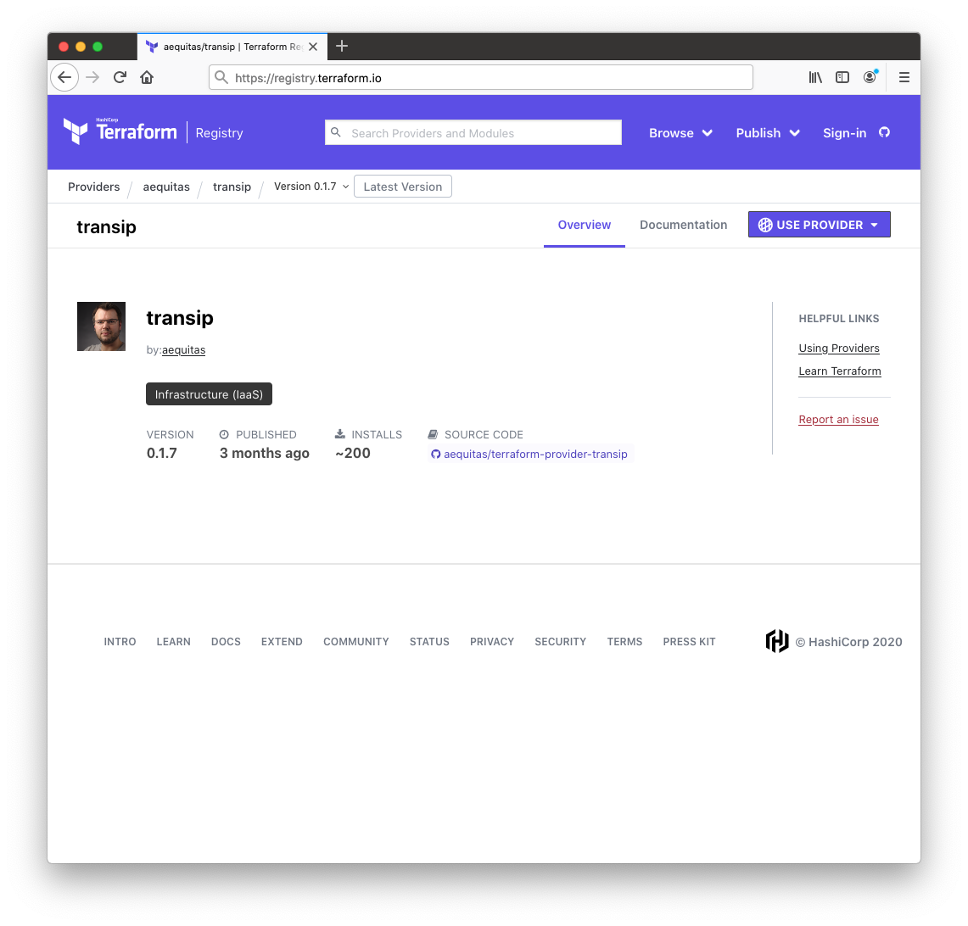
Registry

Slide 29
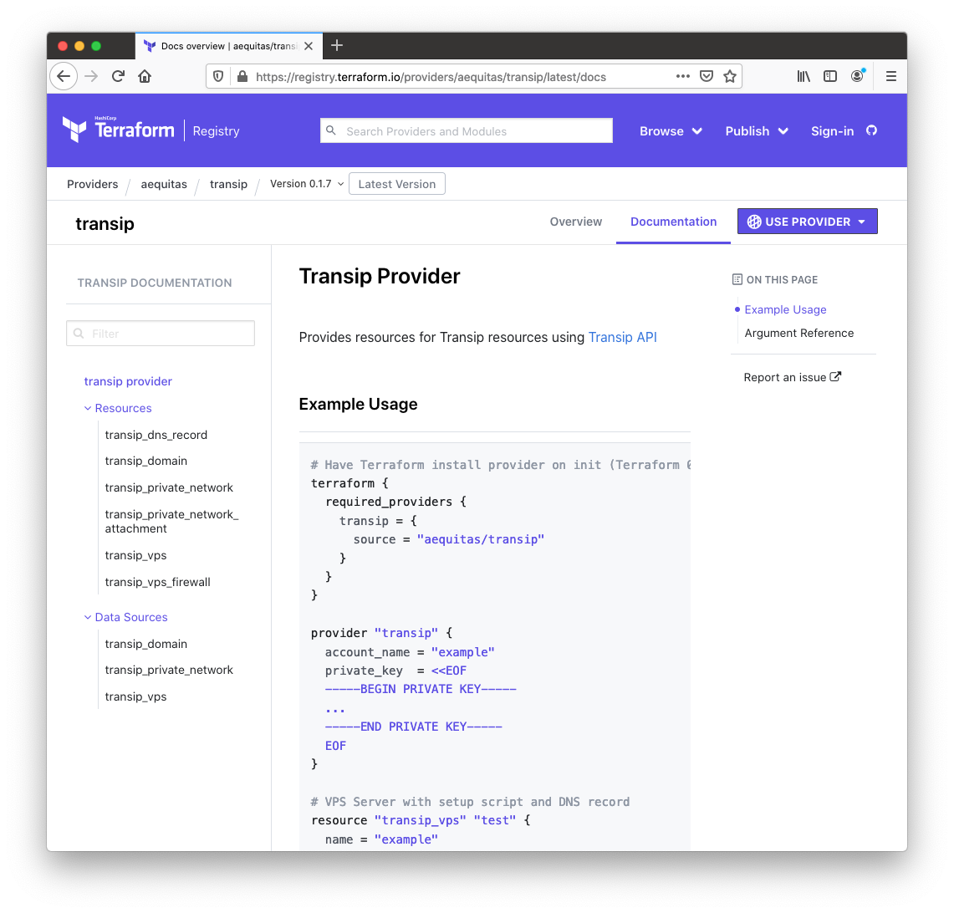
Registry

Slide 30
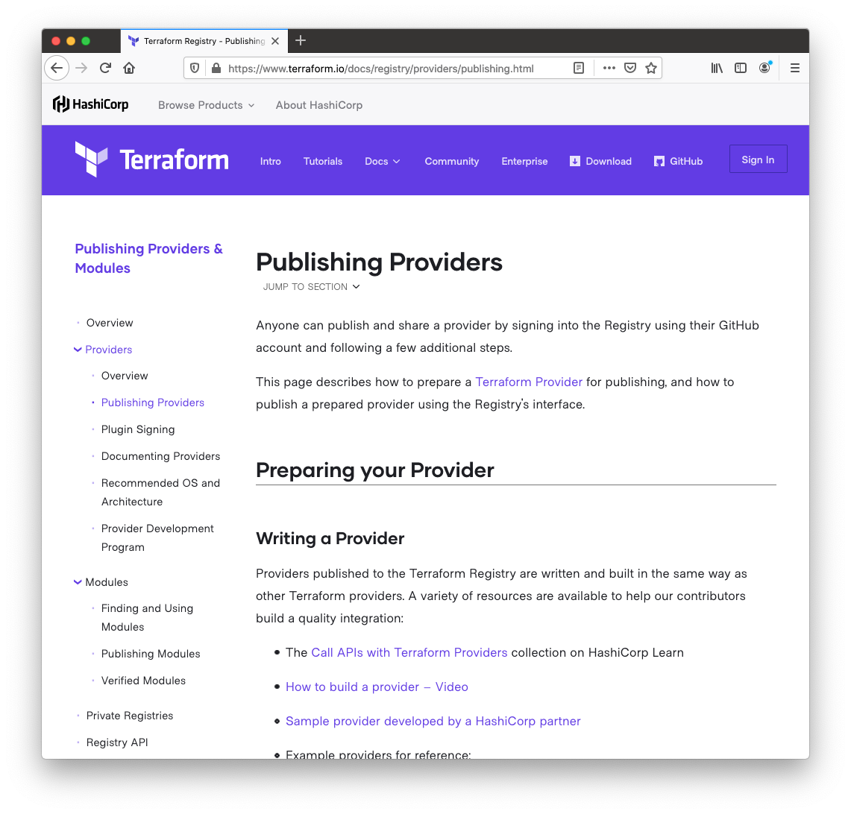
Registry

Slide 31
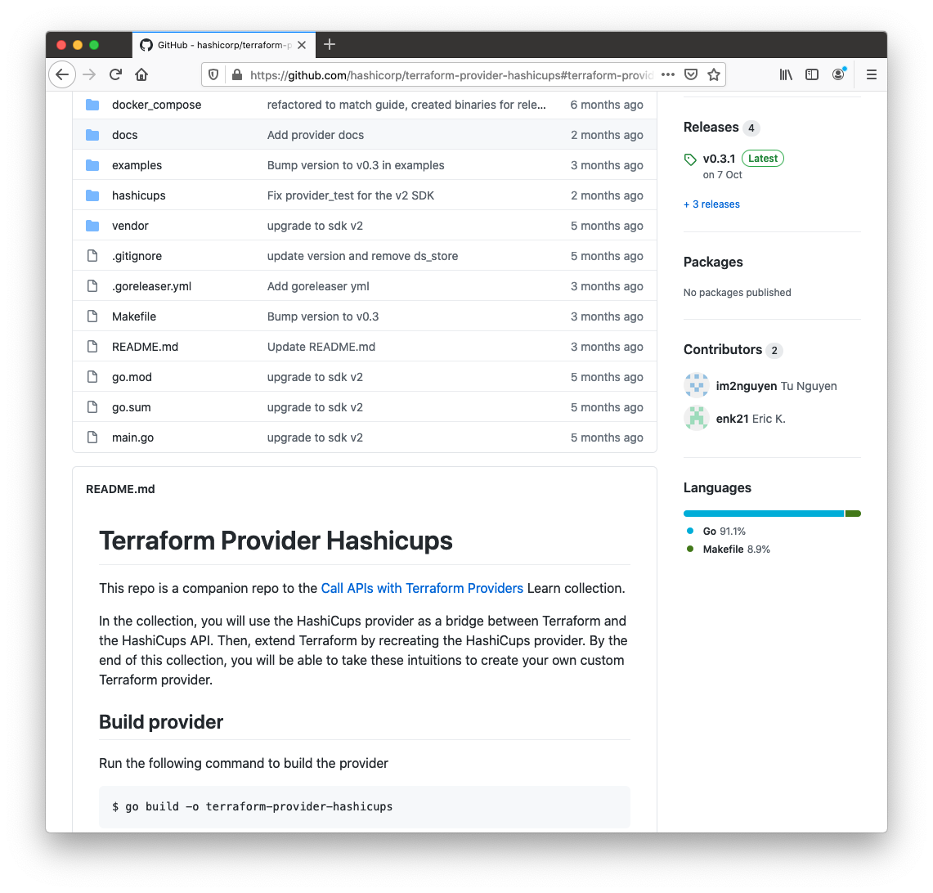
Tutorial

Slide 32
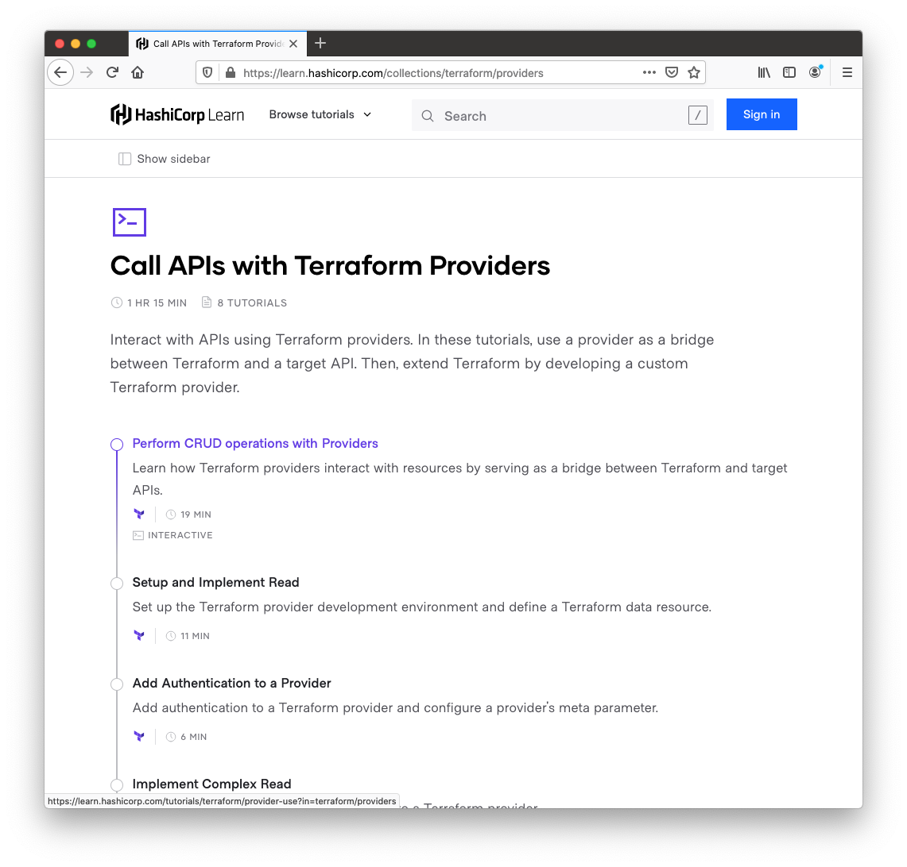
Tutorial

Slide 33
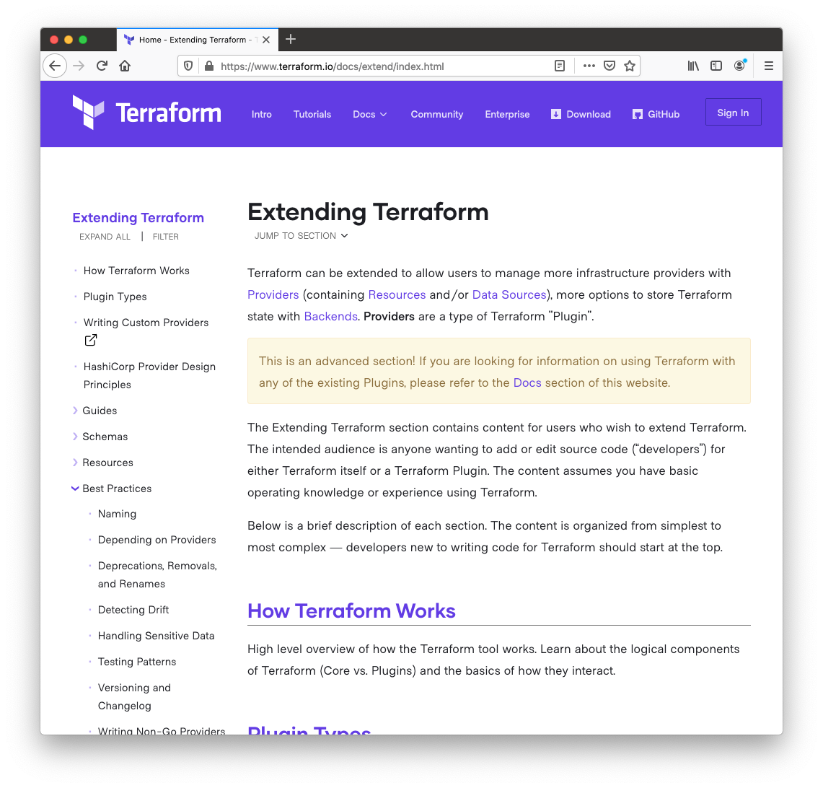
Documentation

Slide 34
Source code and references
https://github.com/aequitas/writing-terraform-providers
https://www.terraform.io/docs/extend/index.html
https://github.com/hashicorp/terraform-provider-hashicups
https://learn.hashicorp.com/collections/terraform/providers

Slide 35
Q & A

Slide 36
FIN

Slide 37


